Slide 1


SAP Full-Stack Developer training
ABAP on HANA, UI5 & Fiori, Analytics with OData
Anubhav Oberoy
Day – 17

Slide 2

Agenda – Day 17
Introduction to SAC (SAP Analytics Cloud)
Defining Phase of SAC
Business Intelligence
Planning
Predictive (ML)
Application Designer
Describing On-Premise vs Cloud
What is SAP Cloud Platform
Modelling in SAC
Types of Model
Define Concept of Account Dimension & Hierarchy
--Break--
Business Intelligence (BI) Feature
Creating BI Stories
Introduction of Planning
SAC Planning Model Basics
Understanding Planning Jargons
Creating Planning Model
Implementing Story on top of Planning Model

Slide 3
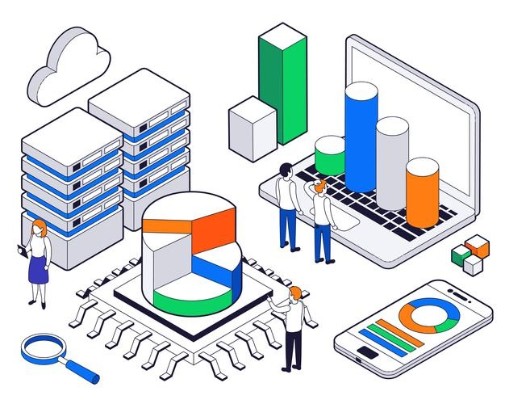
What is SAC ?
(SAC) SAP Analytics cloud is a SaaS offering by SAP for complete BI, Planning, Predictive and designer capabilities.
SAP Analytics Cloud enables the intelligent enterprise by providing everyone with the insights to make confident decisions and take action in the moment.
Hardware Innovation

Slide 4
Defining Phases of SAC
Analytic Designer
Planning with SAC
Predictive Analytics With ML
Building models and BI Stories
Learn Writing Specifications
Live Data Connections
Understand planning jargons
Hardware Innovation

Slide 5
On-Premise vs Cloud
01
Software is consumed as a Service (SaaS).
Hardware to be purchased Networking to be setup.
01
02
No installation required in our company.
License to be bought by paying a lump-sum and licensing cost.
02
On-premise
No hardware, no networking, no need to hire consultants to manage the users.
Cloud
03
Software Innovation
Hire professionals to maintain the system and health of the solution.
03
Complete software is managed by Vendor including patches and upgrades
04
Upgrade and new patches on customer to apply.
Hardware Innovation
04

Slide 6
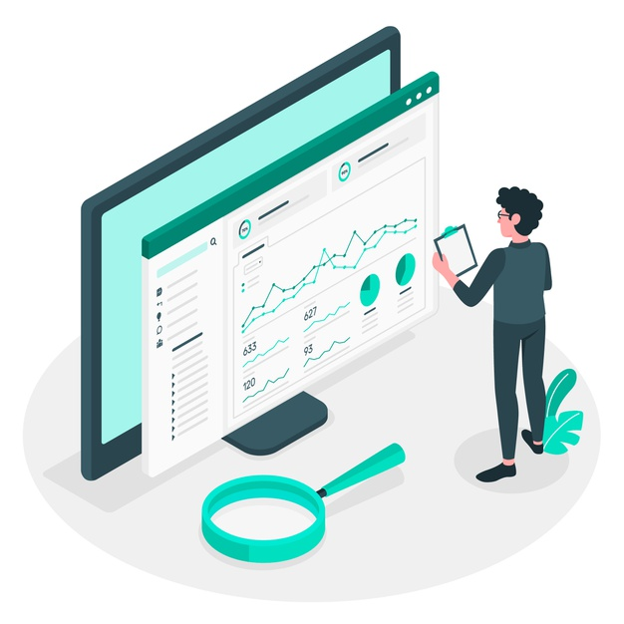
SAP Cloud Platform
SAP Cloud Platform is a platform as a service which provides support for developing applications in the cloud, it offers all what teams need for developing End-to-End enterprise apps which runs natively on cloud like DB, Programming, Monitoring.
It is available in 2 modes
Neo (Obsolete)
CF – Cloud Foundry ( IaaS – AWS, Google, Azure, Alibaba)
Data Center OR region: cloud vendors to achieve scalability, elasticity
and compliance, they have data kept at different locations in
the world which is knowns as Data centers.
SAP Cloud Platform Offerings
https://discovery-center.cloud.sap/serviceCatalog/sap-analytics-cloud
SAP Analytics Cloud is a Software as a Service offered by SAP which is hosted on SAP Cloud Platform Cloud Foundry Environment powered by AWS on 3 regions.
Software Innovation
Hardware Innovation

Slide 7

Set up SAC Trial Account
Software Innovation
Hardware Innovation

Slide 8
Modelling
Model is the foundation which is built using data or connection in SAC for building stories.
Following Steps for why we need Models:
01
Data Wrangling and Cleansing .
02
Blending of Data.
03
Hierarchy
Software Innovation
04
Adding new dimensions and measures.
05
To perform aggregations on measures.

Slide 9
Types of Model
Embedded vs Public
Acquired vs Live
Embedded Models are only used in one story.
Public models can be used in Multiple stories – Reusable.
All the data is stored inside SAC are known as Acquired Data Model.
Live – Only the skeleton of the data is kept in SAC, the data and security is with source system.
01
Analytic vs Planning
Analytics models are used in BI Stories, and Planning models are using in planning scenario, Most of the models are Analytic Models = Account Dimension → Grouping of measure.
A planning model has following mandatory – Account, Category(version), Time, Org.
03
02

Slide 10
Account Dimension & Hierarchy
Account Dimension:
All our measures combining called Account Dimension.
Grouping of all the KPI and also financials it gives Sign (+ve, -ve)
Account Dimension in planning also have version.Category = Actual, Forecast, Budget
Hierarchy:
Representation of our data in TREE Structure, Better visualization to our data
02
Level based Hierarchy
Parent-Child Hierarchy
01

Slide 11

Break

Slide 12
Business Intelligence
BI – Business Intelligence
BI comprises the strategies and technologies used by enterprises for data analysis on historic data and present data for finding patterns and taking future decisions.
Bi is now leveraging machine learning which is field of AI to take confident decisions.
Requirement Collection
Access Data
Prepare Modeling
Visualize Building Story
Predict
Share
Software Innovation
Hardware Innovation

Slide 13
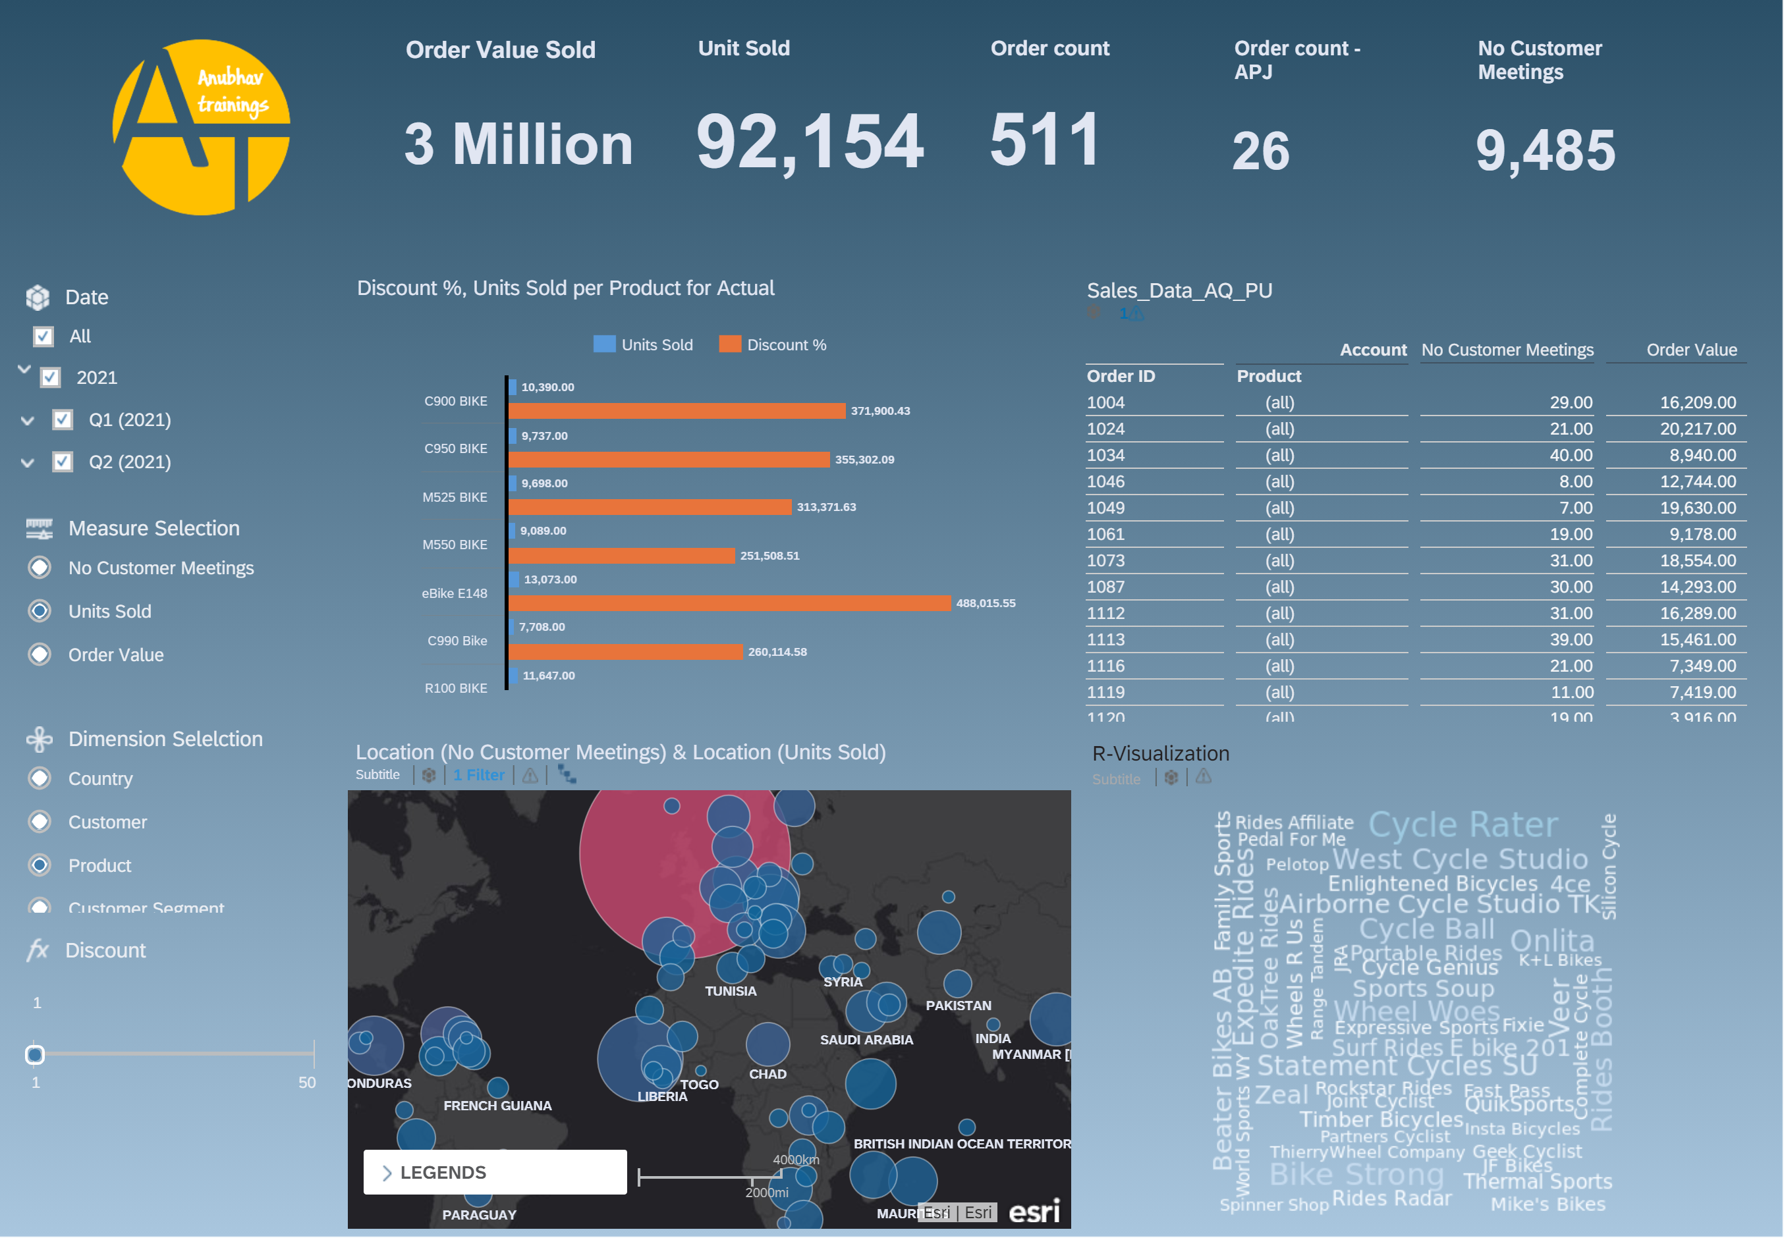
Creating End to End BI Story

Slide 14

What is Planning ?
Planning is a fundamental management function, which involves deciding before head,
What is to be done – TV Commercial
When it will be done – Q1 2021
How it will be done – Allocated 2 mn$
Who is going to do it – Marketing team
Planning is an intellect process which lays down organization objectives and can we achieve the goals which are set and time bound. It chalks out exact how to attain a specific goal. For example how many people I need to hire to achieve a sales of 20 bn mark this year.
Planning is performed for various functions of a company,
such as sales planning, expense, cost.
Planning, and core financials planning to report your co.
numbers to the shareholder.
HR plans for people at all suggested levels
(like Manager, VP, SVP, Associates).
Planning helps us to increase Coordination
and onerous tasks at any co.
Software Innovation
Hardware Innovation

Slide 15
SAC Planning Model Basics
Planning data always have version (Categories – Actuals, Forecast, Budget) - IFRS
2. It is mandatory to have DATE/TIME dimension for the planning model in SAC.
3. We can additionally have Organization Dimension also known as Entity (location of the business) made available in planning model, which helps to get break-up of FIN data.
Region -> Country -> State -> Cities -> Entity (associate with Currency)
Category1
Category 2
Category 3
Actuals
Budget
Forecast
Current facts data which is based on most recent experience or past experience. They relates to reality.
Budgeting is the financial direction of where management wants to take the company, helping qualifying expectations of revenue that business wants to achieve for most recent future
Tells about whether the budget is on track, are we headed in the right direction. Estimating the amount, revenue and income that will achieve in near future.
Software Innovation

Slide 16
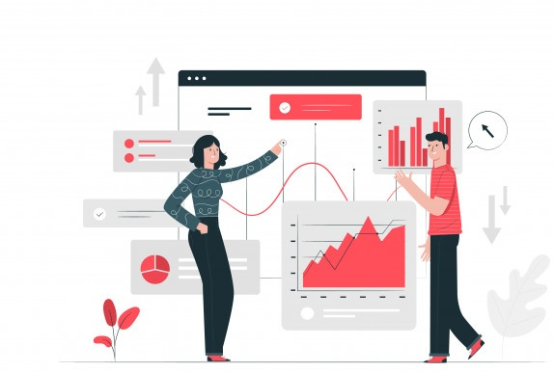
SAC Planning Model Basics
4. Account Dimension –
Represents an account in balance sheet like Gross Profit, Net Revenue, Operating Margin..
Account Dimension always have parent-child hierarchy built automatically
It is used to record, apply formula and aggregate values together.
Each a/c dimension can have a contribution to our Financial planning numbers
+VE – INC, INTINC
- VE – EXP, INT
Neutral – NFIN
5. We can define Business Rules.
6. We plan in local currencies at each entity level and we can report in a common currency - Average, Fix.
7. We will have parent-child hierarchies when we have 2 dimensions together,
its also possible to have one model with both P-C and Level-based hierarchy in SAC.
Software Innovation

Slide 17
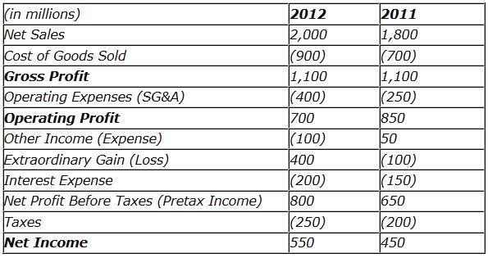

Planning Jargons
Revenue
Total amount of goods and services produced in a span of time is called revenue. – GDP (Country)
Gross Revenue
Total income earned by a co in a specific period, an indicator of potential for growth.
Gross Revenue = Units X Price
Net Revenue
Gross revenue – discounts – returns
Quality of products
Gross Profit = Net Revenue – Cost of Goods (Raw, Machines, Labor, Packaging, Shipping)
Gross Margin % = Gross Profit / Net Revenue
Operating Profit % - operating income / Net Revenue
Operating Expense Ratio % = Operating Expense / Net Revenue

Slide 18
Creating Planning Model
Software Innovation

Slide 19
Implementing Story on top of Model
Software Innovation

Slide 20

End of Day 17

Slide 21

Questions

Slide 22

Anubhav Oberoy

Slide 23


We’re committed to empower you to be
Most Desirable Resource
through powerful training solutions.
We build the workforce of the future.
250+
Corporate Clients
30,000+
Learners Trained
25000+
Learners Placed
FREE WEBINARS
Sign up for free webinars with industry experts every fortnight!
Enroll Now!
Contact us today!
https://anubhavtrainings.com/

Slide 24




More from AnubhavTrainings.com

